Slide 1




Mentorness -Data Analyst Intern MIP-DA-13
Smruti Rajesh Sonekar
WALMART ANALYSIS WITH SQL
Task 2
Notes:
Hello and welcome to Walmart Sales Analysis with Sql!

Slide 2


Data is a precious thing and will last longer than the systems themselves.
Notes:
Data is a precious thing and will last longer than the systems themselves.

Slide 3
Introduction
One of the biggest retail companies in the world, Walmart has an extensive network of physical locations as well as online outlets in several nations. Every day, the business deals with a massive volume of data, including supply chain logistics, consumer preferences, inventory levels, and sales transactions. Walmart needs to analyze this data in order to improve consumer happiness, streamline operations, and spur corporate expansion. The purpose of this research is to examine Walmart's sales trends, spot patterns, and offer practical advice on how to better manage inventories, predict demand, and customize marketing campaigns for various clientele groups. Walmart can better comprehend its market dynamics and keep up its competitive advantage in the retail sector by utilizing data-driven insights.
Notes:
In this research, we'll dive into Walmart's sales trends to uncover patterns and provide actionable insights.
We'll explore ways to improve inventory management, predict demand, and personalize marketing strategies for different customer groups.
Leveraging these data-driven insights will help Walmart understand market dynamics and maintain its competitive edge in the retail industry.

Slide 4



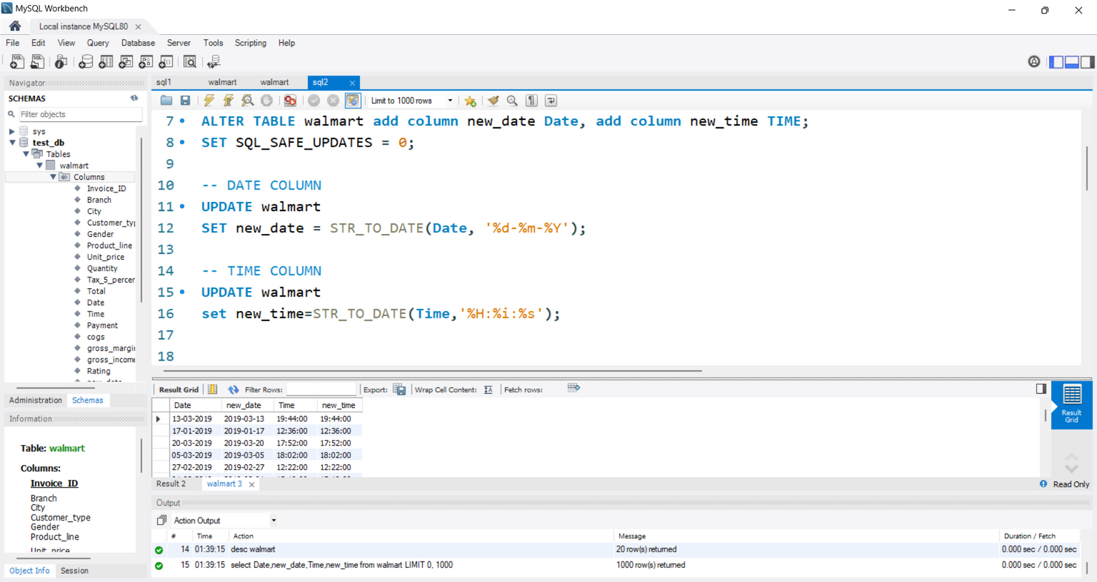
Data Preprocessing
In the sales data file, there are 19 columns out of which there are no null values or missing values.
Time column in "%h-%m-%s" and date column in "Y%-%m-%d" were formatted, and a new column called "new_time" was added. The new columns had the proper formatting, making them easier to see.
Notes:
In our sales data file, we have 19 columns, and great news—there are no missing or null values! To make the data more consistent and easier to analyze, we formatted the time column to "%H-%M-%S" and the date column to "%Y-%m-%d." We also added a new column called "new_time" with proper formatting, enhancing visibility and ensuring the data is ready for deeper analysis.

Slide 5

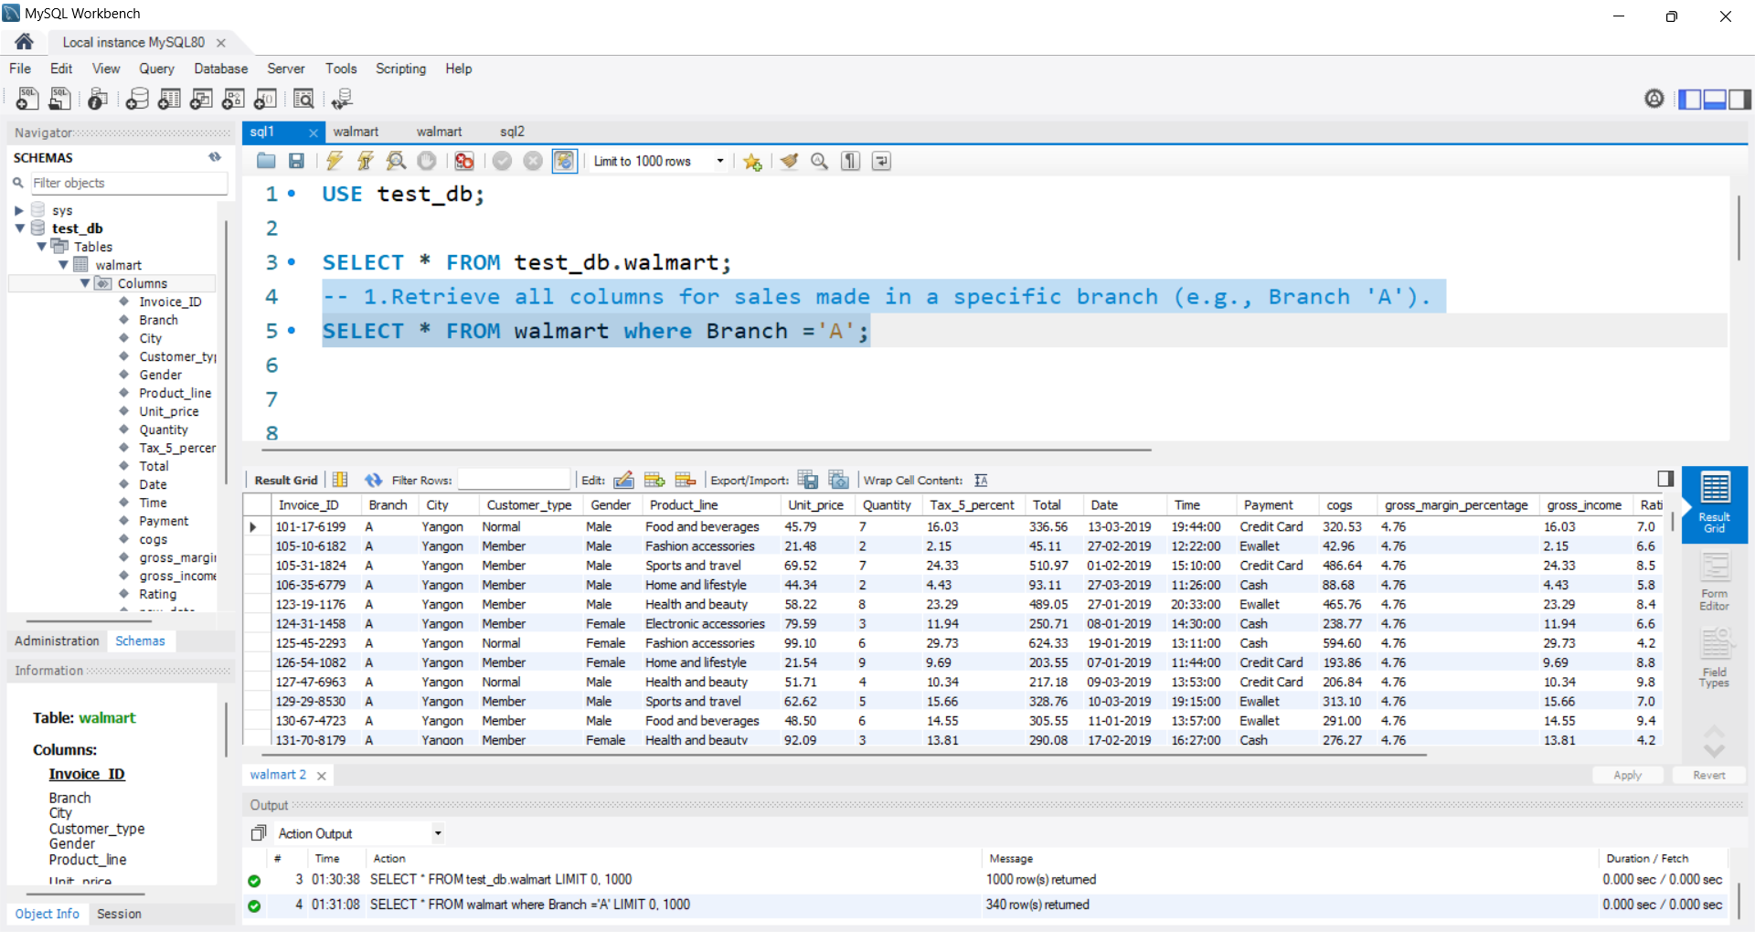
Analysis 1:Retrieve all columns for sales made in a specific branch (e.g., Branch 'A').
In this, we retrieve all the sales from Branch A , which informs us of all the sales done in Branch A, which helps us know which products are most sold, how business or profit is in Branch A , and also helps us identify any potential areas for improvement or expansion in that specific branch. This data can be crucial for making informed decisions regarding inventory management and marketing strategies tailored to Branch A's customer base.
Notes:
Let's dive into the sales data from Branch A! By focusing on this branch, we can uncover the top-selling products, analyze profits, and spot opportunities for growth or improvement. This insight is super valuable for making smart decisions on inventory management and crafting marketing strategies that perfectly fit the needs of Branch A's customers.

Slide 6
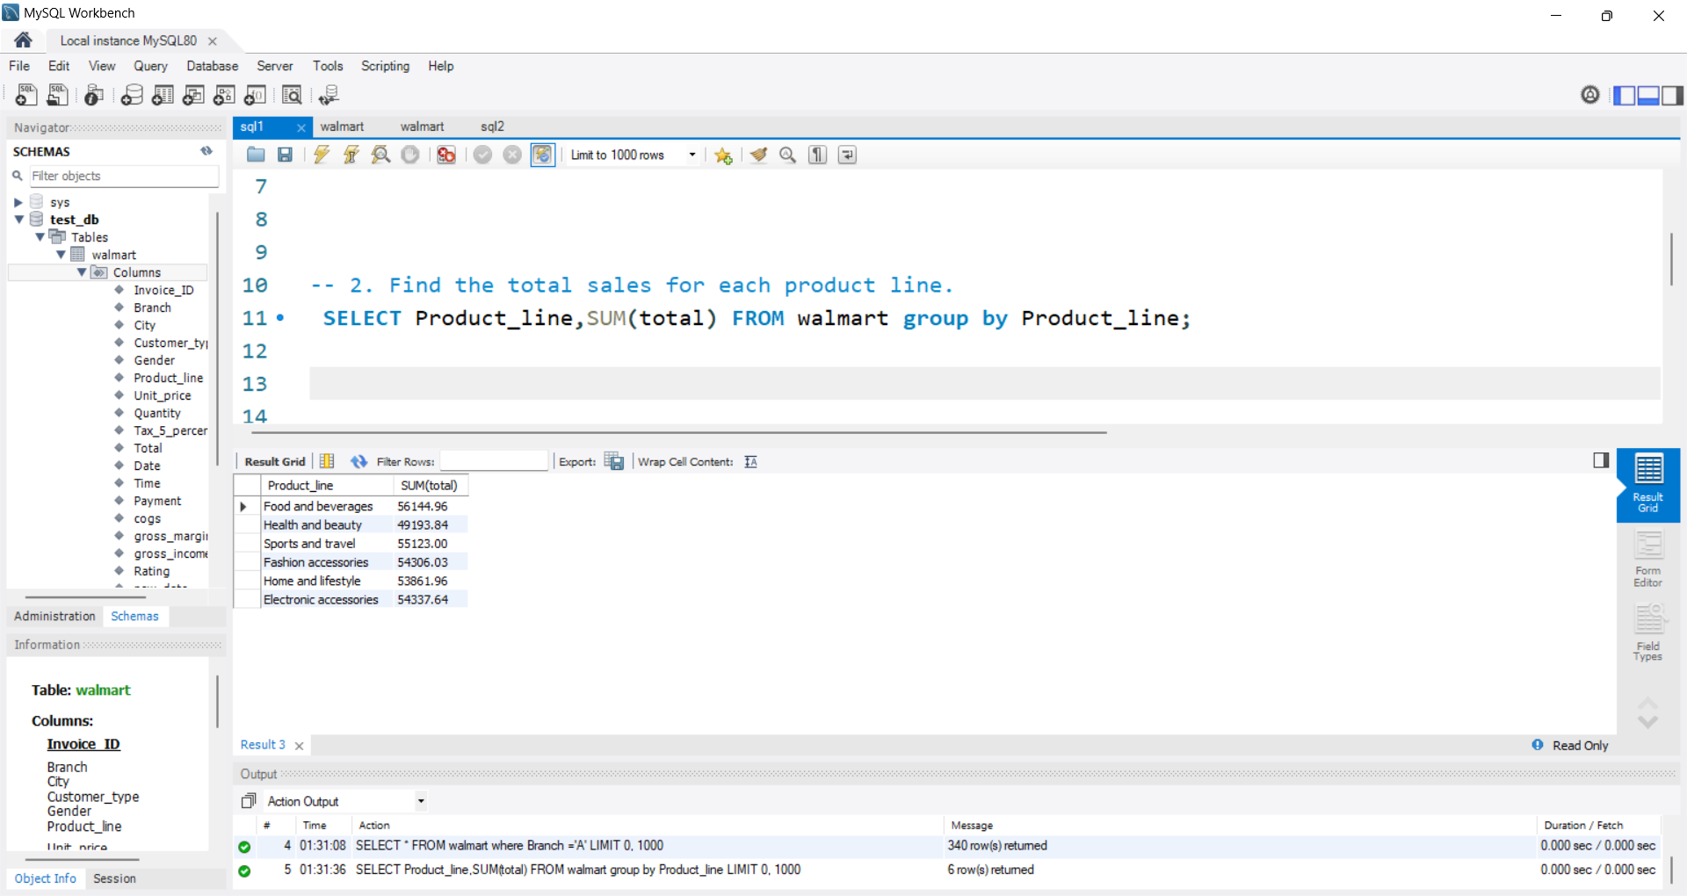
Analysis 1:Find the total sales for each product line.
In this way, we can retrieve all the product lines and total sales for each product line (category), which can help us know which categories are popular and which are underperforming. By analyzing this data, we can make informed decisions on marketing strategies, inventory management, and product development to maximize profits and improve overall business performance. This information can also guide us in identifying trends and opportunities for growth within our product offerings.
Notes:
Now, let's explore all the product lines and their total sales. This helps us identify which categories are hot sellers and which ones might need a little boost. By analyzing this data, we can refine our marketing strategies, optimize inventory, and focus on product development to maximize profits. Plus, this insight helps us spot trends and opportunities for growth, ensuring our product offerings stay ahead of the game!

Slide 7
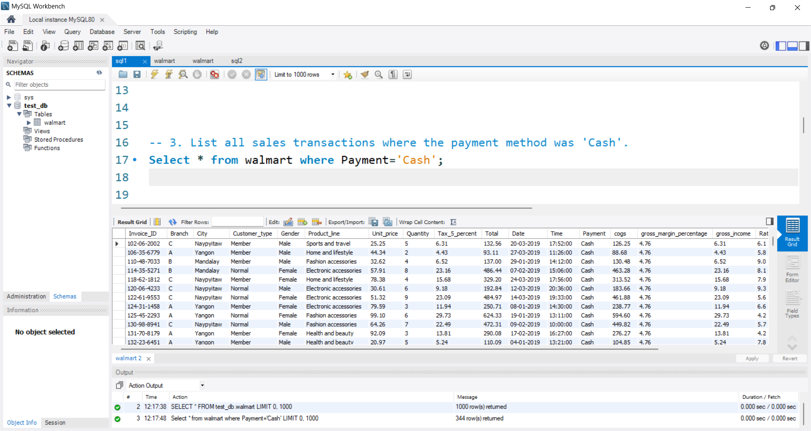
Analysis 1:List all sales transactions where the payment method was 'Cash'.
We want to analyze how much transactions are done in cash and what products people are comfortable buying in cash . This will help us understand consumer behavior and preferences when it comes to payment methods, ultimately guiding our business decisions. Additionally, we can use this data to optimize our inventory and marketing strategies to better cater to our customers' preferences.
Notes:
Let’s focus on all the sales transactions made with cold, hard cash! By pinpointing these cash transactions, we gain insight into customer preferences, allowing us to tailor our strategies for those who prefer this payment method.

Slide 8
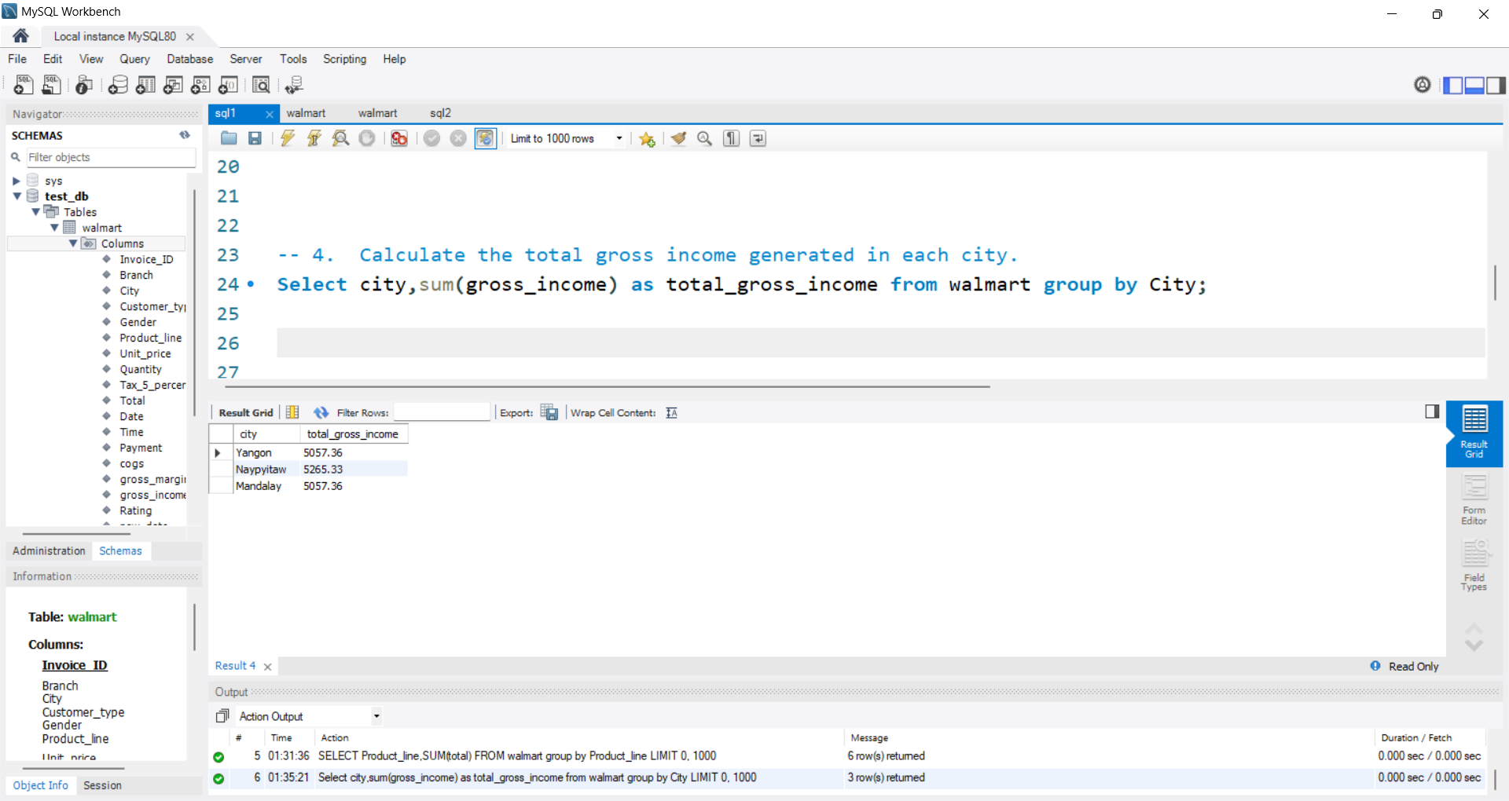
Analysis 1:Calculate the total gross income generated in each city.
We want to analyze income from each city, determine which city is generating more business, and determine how to increase income in an underperforming city. One can alter marketing campaigns based on the city. For example, if a city is not generating as much income as desired, one can tailor marketing strategies to target that specific location. By analyzing income data from each city, businesses can make informed decisions on where to allocate resources for maximum impact.
Notes:
Let's calculate the total gross income for each city! By breaking down the income generated city by city, we can see where we're making the most impact and identify areas with high earning potential. This insight helps us focus our efforts on key locations and optimize our strategies for even greater success!

Slide 9
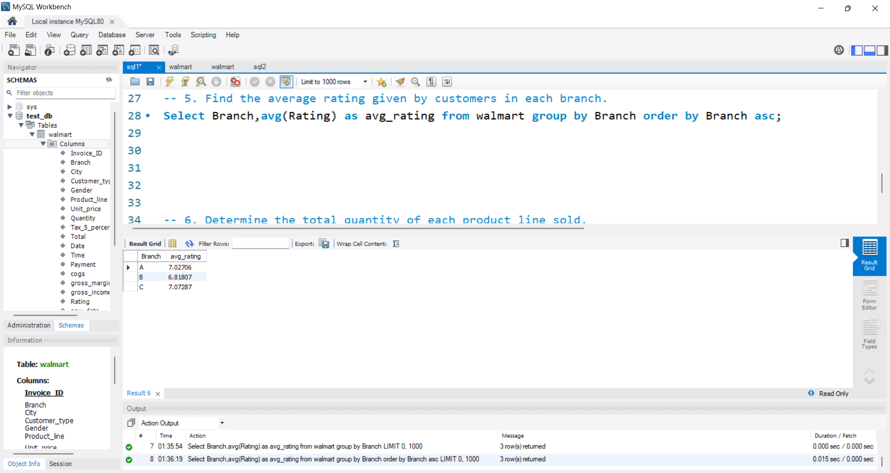
Analysis 1:Find the average rating given by customers in each branch.
In this we checkout rating given by custoemr to analyze their feed back by branch and make improvements accordingly. This helps us to understand the areas where we are excelling and where we may need to focus on enhancing our services for better customer satisfaction.
Notes:
Let’s find out the average customer rating for each branch! By analyzing these ratings, we can see which branches are hitting the mark and which might need a little extra attention.

Slide 10
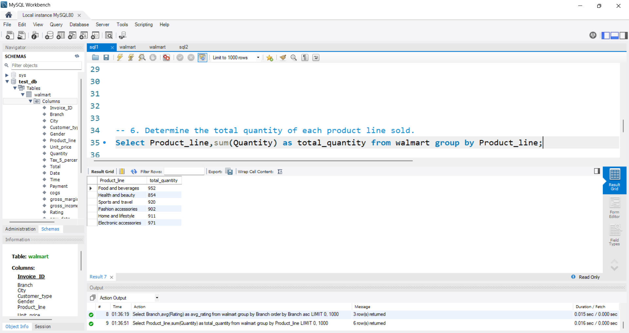
Analysis 1:Determine the total quantity of each product line sold.
In this, we need to know the quantity of the product line to know which one is the best selling category and which one should be added to stock. Analyzing the quantity of each product line will help us make informed decisions about inventory management and future purchasing strategies. This data will also allow us to identify trends and make adjustments to optimize sales and profitability.
Notes:
Let’s tally up the total quantity sold for each product line! This breakdown shows us which product lines are flying off the shelves and which might need a push. Understanding these numbers helps us manage inventory more effectively and tailor our strategies to boost sales for each product category!

Slide 11
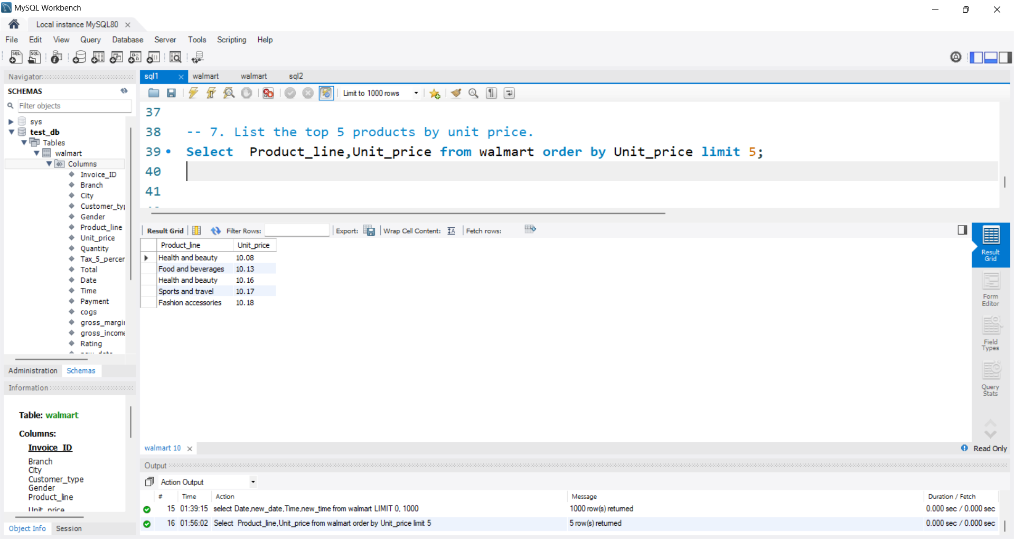
Analysis 1:List the top 5 products by unit price.
In this, we get to know which are the top 5 best selling products and what people are liking the most , which helps us make informed decisions on what products to purchase or invest in. By analyzing trends and consumer preferences, we can better understand market demand and tailor our offerings accordingly.
Notes:
Let’s highlight the top 5 products with the highest unit prices! This spotlight on premium products helps us understand which items are the priciest and potentially most profitable.

Slide 12
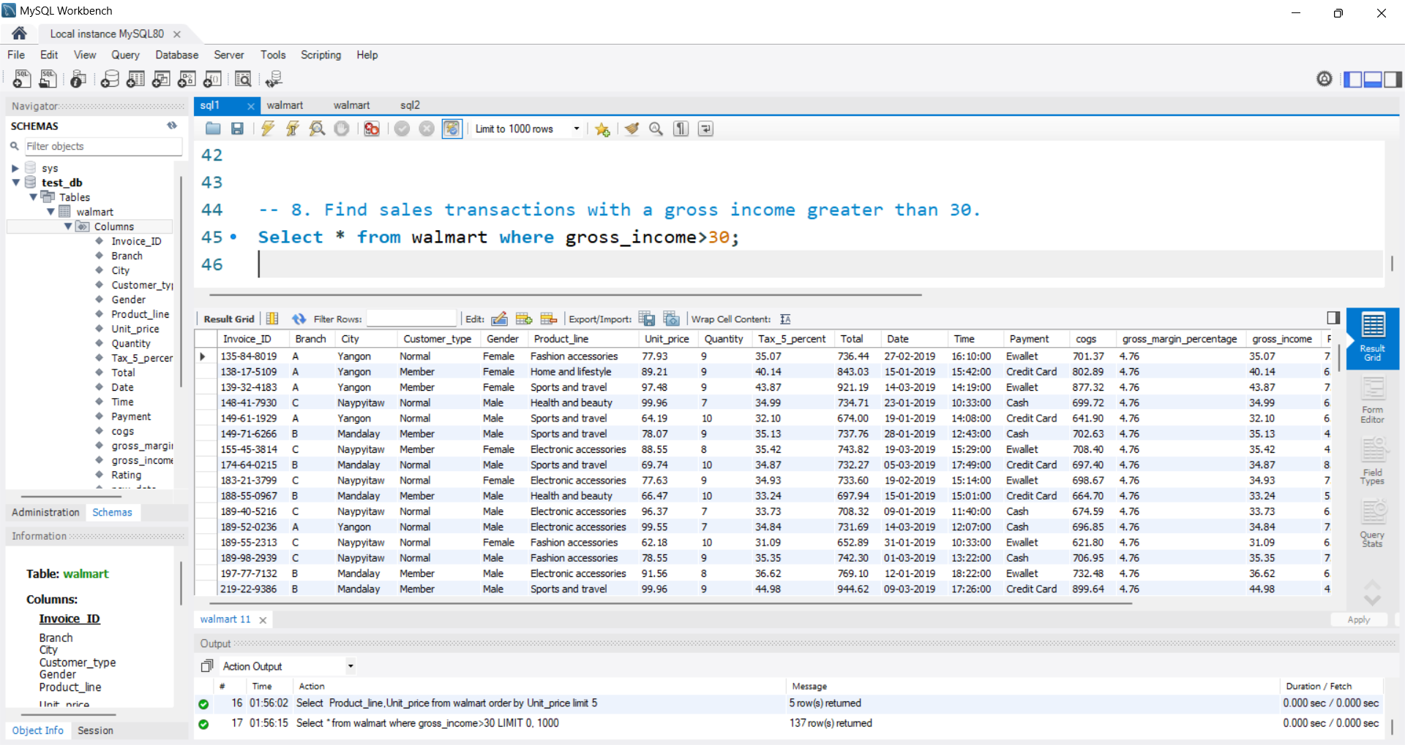
Analysis 1:Find sales transactions with a gross income greater than 30.
It's critical to understand which goods are selling at a higher revenue level and which consumers are purchasing them in bulk in order to analyze sales with a gross income beyond $30. This study may be used to find patterns and chances to boost sales. Businesses may optimize their sales strategy by knowing the correlation between high-grossing sales and particular items or consumer categories.
Notes:
By analyzing these higher-revenue transactions, we can identify which products are driving significant sales and which customers are making those big purchases. This insight helps us spot patterns and opportunities to boost sales further.

Slide 13
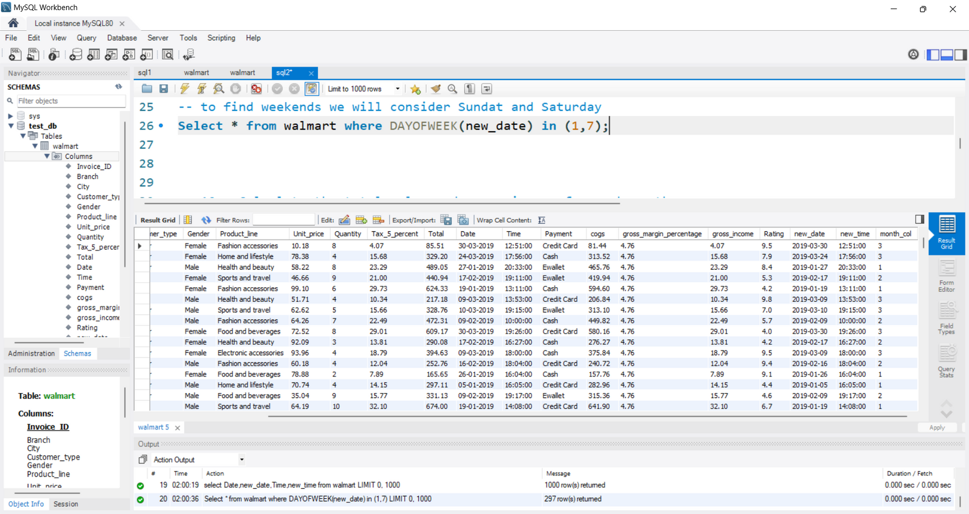
Analysis 1:Retrieve sales transactions that occurred on weekends.
Here in MySQL, we have a function called DAYOFWEEK where
-- 1 means Sunday, 2 means Monday, 3- tuesday , 4-means Wed,5-thurs,6-friday,7-Saturday.
We shall look at Sunday and Saturday in order to determine weekends. Retrieve any weekend-related sales transactions. To do this, we can specify that we wish to get transactions where the outcome is either 1 (Sunday) or 7 (Saturday) by using the DAYOFWEEK function in the WHERE clause of our SQL query. We will be able to select and show just the sales transactions that took place on weekends thanks to this.
Notes:
Let’s dig into the sales transactions that happened on weekends! In MySQL, we use the DAYOFWEEK function to identify the day of the week, where 1 represents Sunday and 7 stands for Saturday. To find weekend transactions, we'll query for days where the function returns either 1 (Sunday) or 7 (Saturday). This approach helps us pinpoint and analyze sales data specifically from weekends, giving us insight into customer behavior and sales patterns on these key days.

Slide 14
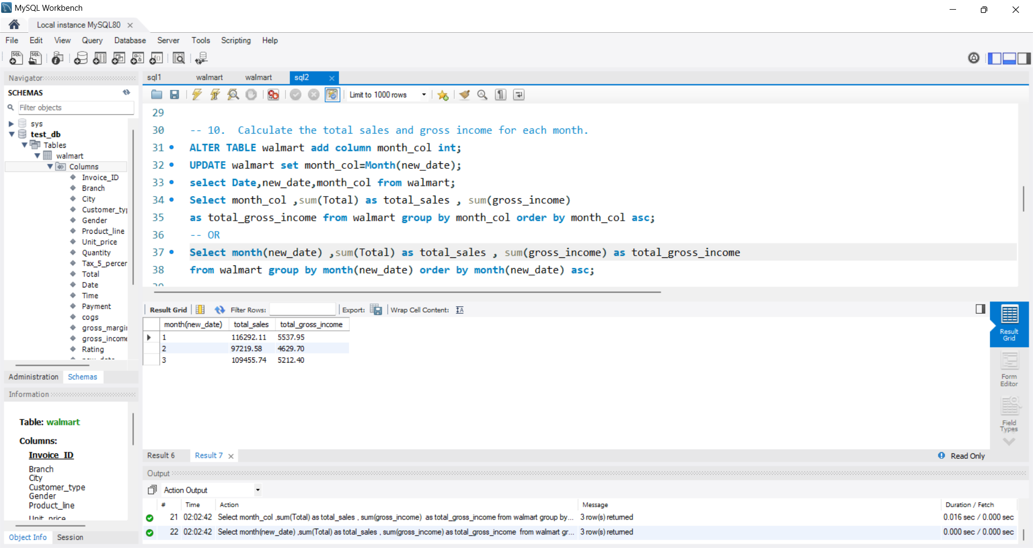
Analysis 1:Calculate the total sales and gross income for each month.
Method 1: Creating a New Month Column: I first extracted the month from the new_date column, which is in DATE format, and created a new column called month. Then, I calculated the total sales grouped by this new month column and ordered the results in ascending order by month.
Method 2: Direct Extraction Without Creating a Column: Instead of creating a new month column, I directly used the MONTH(new_date) function to extract the month within the same query. I then grouped the total sales by this extracted month and ordered the results in ascending order.
Notes:
The query used the MONTH function to extract the month, grouped total sales by this month, and ordered the results in ascending order.

Slide 15
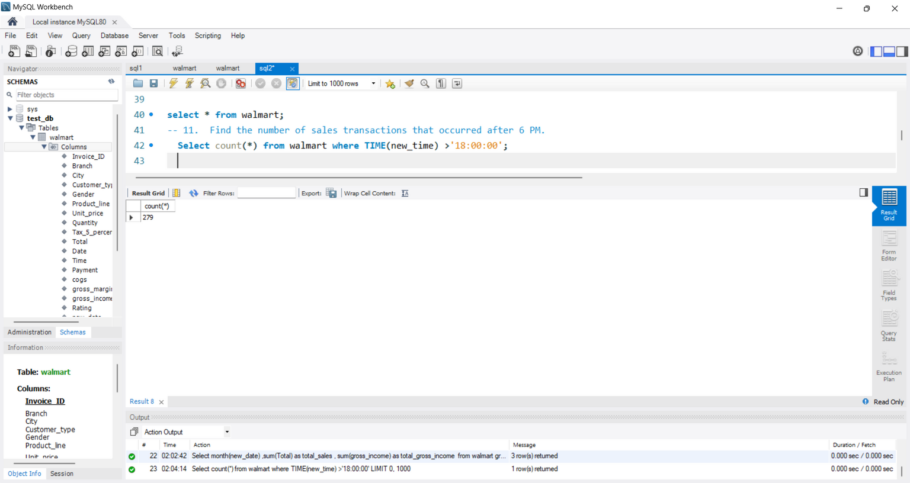
Analysis 1:Find the number of sales transactions that occurred after 6 PM.
Sales after 6 p.m. can reveal to us whether people are interested in shopping after work or whether evenings are the busiest times for consumers to shop. With this information, we can develop promotions or discounts to increase revenue.
Notes:
Let’s uncover how many sales transactions happened after 6 PM! We’re diving into the evening sales to see how busy things get when the sun goes down. By tracking transactions past 6 PM, we can spot late-night shopping trends and maybe even find opportunities to boost sales during those prime after-hours!

Slide 16
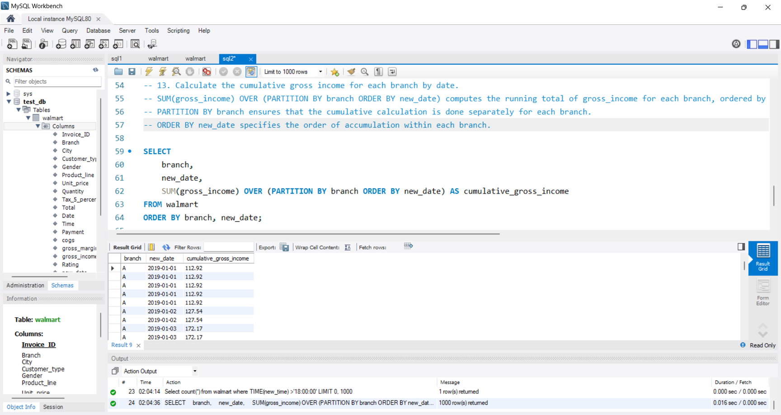
Analysis 1:Calculate the cumulative gross income for each branch by date.
To calculate the cumulative gross income for each branch by date, the query uses the SUM(gross_income) OVER (PARTITION BY branch ORDER BY new_date) function. This function computes a running total of gross_income for each branch, starting from the earliest date (new_date) and adding up the income as it progresses. The PARTITION BY branch part ensures that the running total is calculated separately for each branch, meaning the accumulation resets for each branch. The ORDER BY new_date part specifies that the running total should be calculated in chronological order for each branch. This allows you to see how the gross income accumulates over time within each branch.
Notes:
To calculate the cumulative gross income for each branch over time, we use the SUM(gross_income) OVER (PARTITION BY branch ORDER BY new_date) function. This command adds up the gross income for each branch, starting from the earliest date and continuing forward.
PARTITION BY branch: Separates the totals by each branch, so the running total starts fresh for each branch.
ORDER BY new_date: Ensures the totals are calculated in the order of dates, showing how income builds up over time for each branch.
This method lets us track the growing gross income for

Slide 17
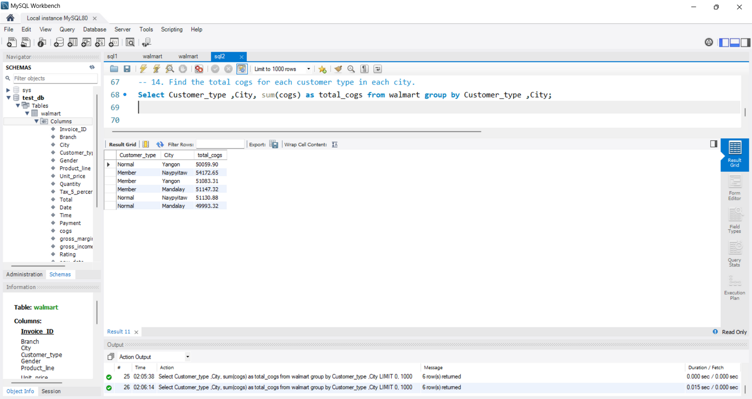
Analysis 1:Find the total cogs for each customer type in each city.
In this analysis, it is important to sort the cost of goods according to the customer and city so that we know how to effectively price our products and services in different markets. This data can help us identify trends and make informed decisions on pricing strategies for each target demographic.
Notes:
Let's find out the total Cost of Goods Sold (COGS) for each customer type in every city! We'll group the data by both customer type and city, then calculate the sum of COGS for each combination. This will give us a clear picture of how COGS varies across different customer types and locations.

Slide 18
Conclusion
It is important to include all categories and consumer feedback in all of these evaluations of Walmart sales data. Walmart's tagline is "Save Money, Live Better," and this sales study reflects the essence of their commitment to provide consumers with high-quality goods at a fair price. According to the entire analysis, consumers are constantly interested in fashion, cuisine, lifestyle, and health items.
They also want a range of products, and their income from various cities helps us determine which things are worth stocking up on and which ones shouldn't be as important. Walmart is able to meet the varied demands and preferences of its consumers thanks to this data-driven strategy, which eventually boosts sales and improves customer happiness.
Notes:
Walmart’s "Save Money, Live Better" motto shines through our sales study! With insights into consumer preferences across fashion, food, lifestyle, and health, we see what’s hot and what’s not. By tuning into this data, Walmart can stock up on what customers love and keep them smiling, boosting sales and satisfaction all around.

Slide 19



thank you
Notes:
Thank you so much!

